Slide 1
Apache Hadoop and MapReduce programming model

Slide 2
How things began
1998 – Google founded:
  Need to index entire Web – terabytes of data
  No other option than distributed processing
  Decided to use clusters of low-cost commodity PC’s instead of expensive servers
  Began development of specialized distributed file system, later called GFS
  Allowed to handle terabytes of data and scale smoothly

Slide 3
Few years later
Key problem emerge:
  Simple algorithms: search, sort, compute indexes etc.
  And complex environment:
    Parallel computations (1000x of PCs)
    Distributed data
    Load balancing
    Fault tolerance (both hardware and software)
Result - large and complex code for simple tasks

Slide 4
Solution
Some abstraction needed:
  To express simple programs…
  and hide messy details of distributed computing
Inspired by LISP and other functional languages

Slide 5
MapReduce algorithm
Most programs can be expressed as:
  Split input data into pieces
  Apply Map function to each piece
    Map function emits some number of (key, value) pairs
  Gather all pairs with the same key
  Pass each (key, list(values)) to Reduce function
    Reduce function computes single final value out of list(values)
  List of all (key, final value) pairs is the result

Slide 6
For example
Process election protocols:
  Split protocols into bulletins
  Map(bulletin_number, bulletin_data) { emit(bulletin_data.selected_candidate,1); }
  Reduce(candidate, iterator:votes) {
  int sum = 0;
  for each vote in votes
  sum += vote;
  Emit(sum);
  }

Slide 7
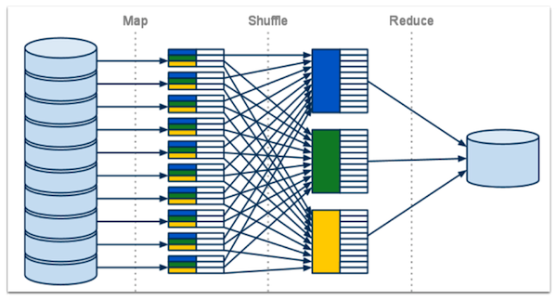
And run in parallel

Slide 8
What you have to do
Set up a cluster of many machines
  Usually one master and many slaves
Pull data into cluster’s file system
  distributed and replicated automatically
Select data formatter (text, csv, xml, your own)
  Splits data into meaningful pieces for Map() stage
Write Map() and Reduce() functions
Run it!

Slide 9
What framework do
Manages distributed file system(GFS or HDFS)
Schedules and distributes Mappers and Reducers across cluster
Attempts to run Mappers as close to data location as possible
Automatically stores and routes intermediate data from Mappers to Reducers
Partitions and sorts output keys
Restarts failed jobs, monitors failed machines

Slide 10
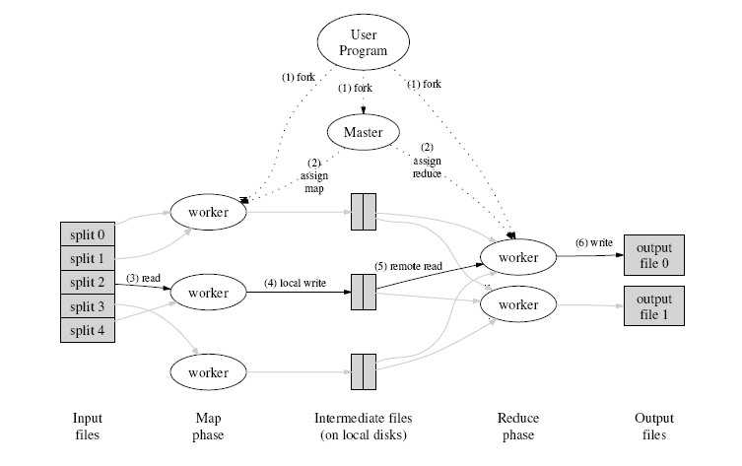
How this look

Slide 11
Distributed reduce
There are multiple reducers to speed up work
Each reducer provides separate output file
Intermediate keys from Map phase are partitioned across Reducers
  Balanced partitioning function is used, based on key hash
  Same keys go into single reducer!
  User-defined partitioning function can be used

Slide 12
Handling multiple outputs
Can be processed outside the cluster
  Amount of output data is usually much smaller
User-defined partitioner can sort data across outputs
  Need to think about partitioning balance
  May require separate smaller MapReduce step to estimate key distribution
Or just pass as-is to next MapReduce step

Slide 13
Now let’s sort
MapReduce steps can be chained together
Built-in sort by key is actively exploited
First example output was sorted by candidate name, voice count is the value
Let’s re-sort by voice count and see the leader
  Map(candidate, count)
  {Emit(concat(count,candidate), null)}
  Partition(key)
  {return get_count(key) div reducers_count;}
  Reduce(key,values[]) { Emit(null) }

Slide 14
What happened next
2004 - Google tells world about their work:
  GFS file system, MapReduce C++ library
2005 - Doug Cutting and Mike Cafarella create their open-source implementation in Java:
  Apache HDFS and Apache Hadoop
Big Data wave hits first Facebook, Yahoo and other internet giants, then others
Tons of tools and cloud solutions emerge around
2013, Oct 15 – Hadoop 2.2.0 released

Slide 15
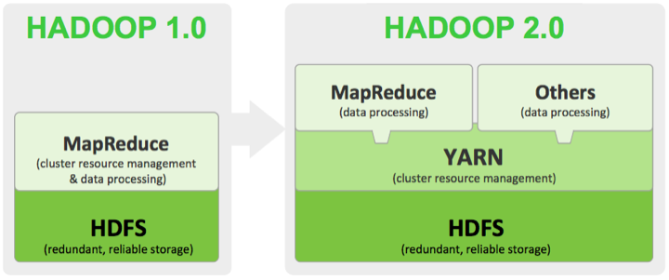
Hadoop 2.2.0 vs 1.2.1
Moves to more general cluster management
Better Windows support (still little docs)

Slide 16
How to get in
Download from http://hadoop.apache.org/
  Explore API doc, example code
  Pull examples into IDE, resolve dependencies by linking JAR’s, try to write your MR code
  Export your code as JAR

Slide 17
And run
Hortonworks or Cloudera Sandbox
  Bundled VM images
  Single-node Hadoop ready to use
  All major Hadoop-based tools also installed
  Apache Hue – web-based management UI
  Educational – only license
http://hortonworks.com/products/hortonworks-sandbox/

Slide 18
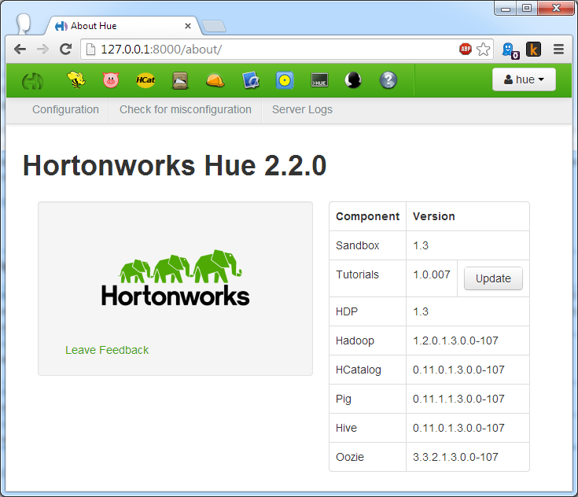
UI look

Slide 19
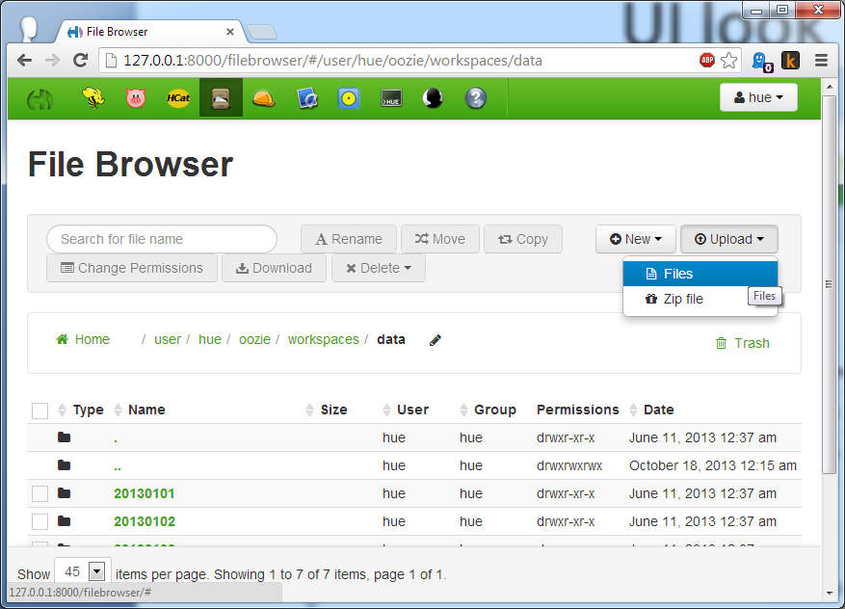
Let’s pull in some files

Slide 20
Standard word count
Job Designer-> New Action->Java
  Jar path /user/hue/oozie/workspaces/lib/hadoop-examples.jar
  Main class org.apache.hadoop.examples.WordCount
  Args /user/hue/oozie/workspaces/data/Voroshilovghrad_SierghiiViktorovichZhadan.txt /user/hue/oozie/workspaces/data/wc.txt

Slide 21
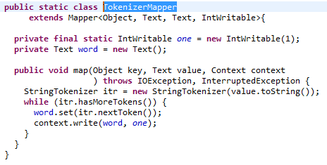
TokenizerMapper

Slide 22
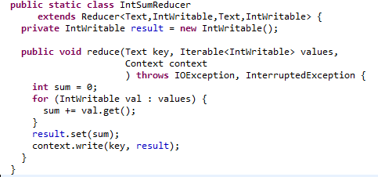
IntSumReducer

Slide 23
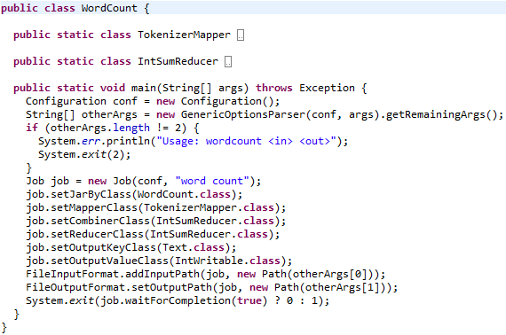
WordCount

Slide 24
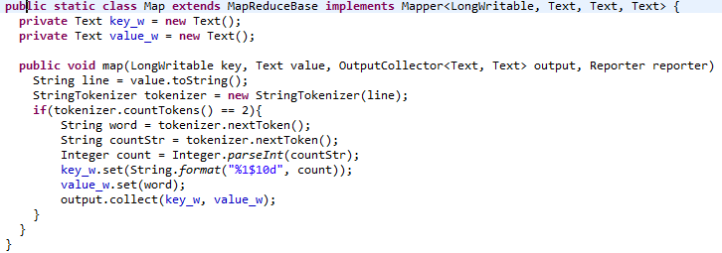
Now let’s sort the result

Slide 25
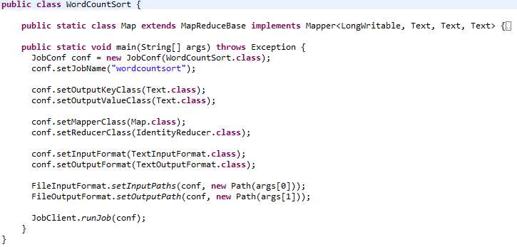
WordSortCount

Slide 26
Sources
http://research.google.com/archive/mapreduce.html
http://hadoop.apache.org
http://hortonworks.com/products/hortonworks-sandbox/
http://stackoverflow.com/questions/tagged/hadoop

Slide 27

Thanks!

